Slide 1
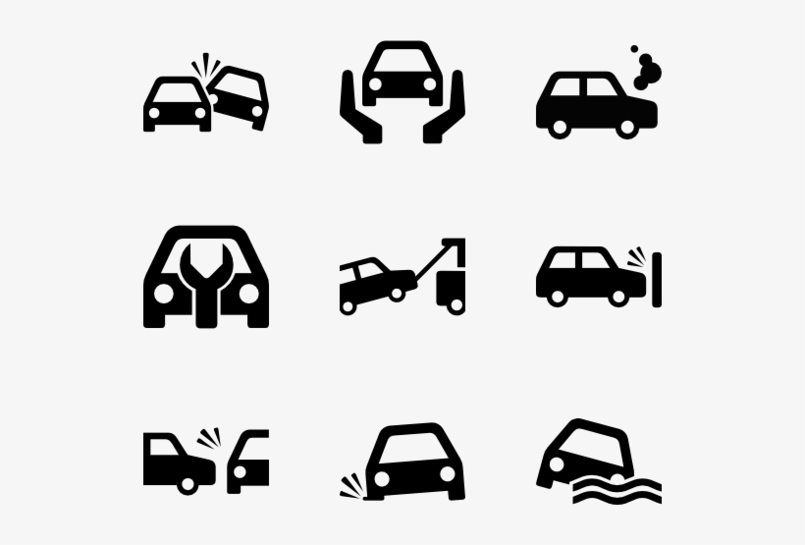
Predicting Car Accident Severity – A Case Study of Seattle, Washington D.C.
By,
Suhas V Londhe

Slide 2
Index
Introduction – Business problem
Key facts
General facts & factors affecting the road accident
Data
Feature Selection
Methodology
EDA (Exploratory Data Analysis)
Modelling, testing and evaluation
Results
Conclusion

Slide 3
Introduction – Business problem
Road Accident refers to any accident involving at least one road vehicle, occurring on a road open to public circulation, and in which at least one person is injured or killed. Intentional acts (Murder, suicide) and natural disasters are excluded.
Road traffic injuries cause considerable economic losses to individuals, their families, and to nations as a whole. These losses arise from the cost of treatment as well as lost productivity for those killed or disabled by their injuries, and for family members who need to take time off work or school to care for the injured. Road traffic crashes cost most countries 3% of their gross domestic product.
Analysing a significant range of factors, including weather conditions, special events, roadworks, traffic jams among others, an accurate prediction of the severity of the accidents can be performed.
The aim of this project is to predict the accident severity in Seattle, reasons for the accident, and where it could happen, in order to mitigate and limit future occurrences and ensure the safety of lives and properties.
Our targeted audiences are Seattle City Council, Government, and decision-makers, the general public, and Seattle Traffic Management Division-SDOT.

Slide 4
Key facts
The US Department of Transportation recently reports that 871 Billion is the economic loss of motor vehicle crashes every year in the US.
This figure includes 271 Billion in economic loss and 594 Billion in harms from loss of lives and the pain.
Every year the lives of approximately 1.35 million people are cut short as a result of a road traffic crash. Between 20 and 50 million more people suffer non-fatal injuries, with many incurring a disability as a result of their injury.
Seattle is the largest seaport city on the West Coast of the United States. According to the data released in 2019, the metropolitan population stands at 3.98million. In July 2016, it was the fastest major growing city in the USA, with an annual growth rate of 3.1%.
Approximately 1.35 million people die each year as a result of road traffic crashes. The 2030 Agenda for Sustainable Development has set an ambitious target of halving the global number of deaths and injuries from road traffic crashes by 2020.

Slide 5
General facts & factors affecting the road accident
Age - Road traffic injuries are the leading cause of death for children and young adults aged 5-29 years.
Sex - From a young age, males are more likely to be involved in road traffic crashes than females. About three quarters (73%) of all road traffic deaths occur among young males under the age of 25 years who are almost 3 times as likely to be killed in a road traffic crash as young females.
Alcohol Consumption - Several studies ahows that drinking an alcohol & driving the vehicle leads to the accidents as alcohol directly impacts on the nerve cells of the brain; resulting in uncontrolled human behavior
Speeding - High speed driving is the another cause of road accidents. At times, high speed vehicle is unable to be controlled at the urgent situation, thus, results in a collision.
Sleep deprivation - Various factors such as fatigue or sleep deprivation might increase the risk, or numbers of hours driving might increase the risk of an accident.
Road Design - The road or environmental factor was either noted as making a significant contribution to the circumstances of the crash, or did not allow room to recover.

Slide 6
7. Seat Belts - Research has shown that, across all collision types, it is less likely that seat belts were worn in collisions involving death or serious injury, rather than light injury; wearing a seat belt reduces the risk of death by about 45 percent.
8. Maintenance - A well-designed and well-maintained vehicle, with good brakes, tires and well-adjusted suspension will be more controllable in an emergency and thus be better equipped to avoid collisions.
9. Drug use - Including some prescription drugs, over the counter drugs (notably antihistamines, opioids and muscarinic antagonists), and illegal drugs.
10. Use of mobile while driving - Drivers using mobile phones are approximately 4 times more likely to be involved in a crash than drivers not using a mobile phone.
11. Traffic Law Enforcement Failure - Every country in the world have their own laws, rules & regulations on transportation; such as road, coastal, air etc. It is necessary to all the citizens that all the laws should be strictly followed in order to avoid any accident.
12. Immediate medical treatment failure - It is observerd that, after the accident, it takes a lot of important time to give the emergency medical treatment to the humans surviving from the road accident.

Slide 7
Data
The source of the data is Seattle Traffic Management Division-SDOT- ( A US state Government Agency), as provided through a link on Coursera in CSV format. This particular dataset starts from 2004 and is updated weekly till this present time.
https://s3.us.cloud-object-storage.appdomain.cloud/cf-courses-data/CognitiveClass/DP0701EN/version-2/Data-Collisions.csv
This data was provided by the Seattle Police Department and recorded by the Traffic Records Department.
The dataset consists of 38 independent fields and 194673 records, which includes both numerical and categorical data.
The dependent field or label for the data set is SEVERITY CODE, which describes the fatality of an accident.
The information contained in the data includes - Speed, Collision Type, Weather situation, Severity Code, Location, Address Type, Road Condition, Status, Vehicle etc.
Severity of each accident is given as a binary variable with the value '1' if the accident was less serious and '2' if the accident was severe. "Severity Code" column will be used from this dataset as a dependent variable / target variable that will be predicted in this project.

Slide 8
Feature Selection
The goal of this study is the development of a model that predicts the severity of an accident using real-time data, this puts some limits on the type of features that can be used since not all of the dataset’s columns contain information that can be obtained in real-time.
The dependent variable or target variable for the data set is "SEVERITY CODE", which describes the fatality of an accident.
Other attributes that have been taken into consideration for the analysis are as follows –
LOCATION - Description of the general location of the collision
ADDRTYPE - Collision address types are 'Alley', 'Block' or 'Intersection‘
ROADCOND - The condition of the road during the collision. (e.g. ‘Wet’, ‘Dry’ etc.)
WEATHER - A description of the weather conditions during the time of the collision
JUNCTIONTYPE - Category of junction at which collision took place
PERSONCOUNT - The total number of people involved in the collision
VEHCOUNT - The number of vehicles involved in the collision
LIGHTCOND - The light conditions during the collision
SPEEDING - Whether or not speeding was a factor in the collision

Slide 9
Methodology
Python libraries required for this project are imported. E.g. Pandas, scikit, matplotlib, seaborn etc.
Data in a ‘CSV’ format is imported using ‘Pandas’ library & converted the data into a dataframe.
Data imbalance is checked in order to avoid the data imperfection.
Undersampling - On performing a count of values on the DataFrame, it is observed that the dependent variable is an unbalanced label. Hence, undersampling is done.
Missing value treatment is done by replacing ‘nan’ values.

Slide 10
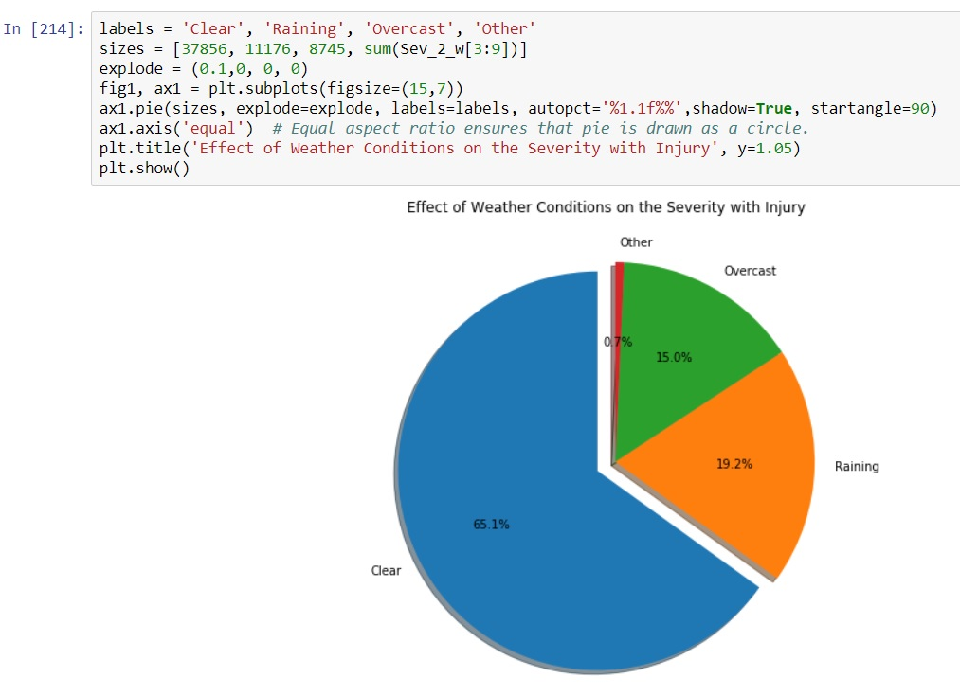
EDA (Exploratory Data Analysis)
Relationships between different independent variables with dependant variable is visualized using pie chart.

Slide 11
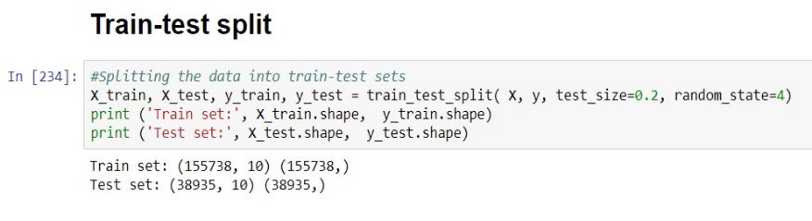
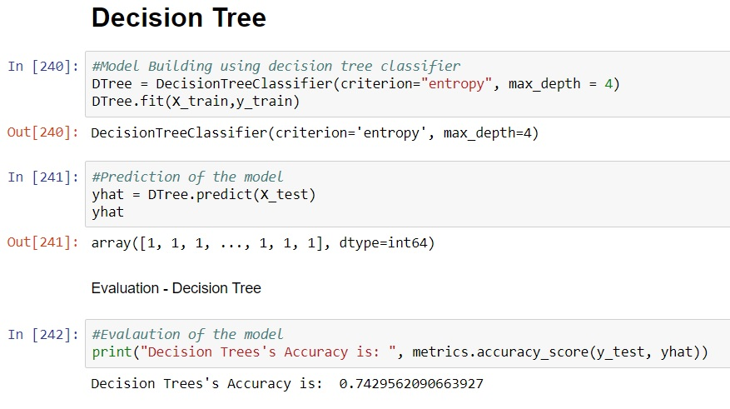
Modelling, testing and evaluation
Train-Test Split - Dataset is divided into training & testing set. 80% data is used for training the model & 20% data is used for testing the model using train-test split method.
4 machine learning algorithms are used in modelling. We will only see decision tree modelling here -

Slide 12
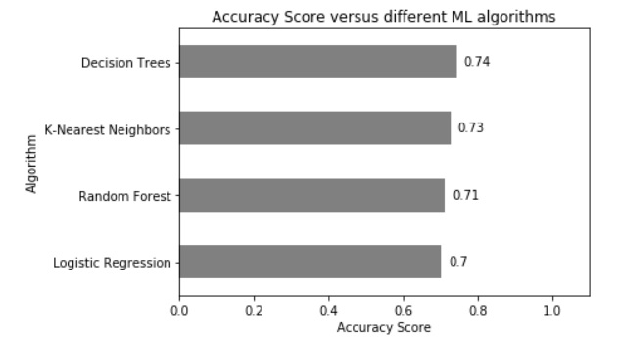
Results
We plotted the accuracy score for all machine learning algorithms. We found that, Decision Tree algorithm gave the highest accuracy amongst all 4 algorithms.

Slide 13
Conclusion
After comparing the score of accuracies obtained by the different machine learning algorithms K-Nearest Neighbors, Decision Tree, Logistic Regression, and Random Forest; Decision Tree algorithm has been proved to give the better accuracy.
During the modeling with K-Nearest Neighbors classifier, it was observed that the computer required much more time. But it took less time to execute the decision tree modeling. This can also represent better effectiveness and compatibility of the decision tree for handling this given dataset.
In this study, supervised machine learning is applied to predict car accident severity. The imbalanced dataset is initially balanced, and the raw data is analyzed and prepared in different steps to be fed into the machine learning models. In parallel, an explanatory data analysis is done to gain more insights into the relationship between the features and the severity of the accidents.
Four machine learning algorithms (K-Nearest Neighbors, Decision Trees, Logistic Regression, and Random Forest) are applied in which the decision tree has shown better compatibility with the dataset, resulting in higher accuracy (0.74).
One idea for future work can be applying feature selection algorithms such as LASSO to better select features. Enriching data further with other approaches to handling missing values can potentially improve prediction accuracy. Furthermore, testing other attributes related to car drivers, such as their age, can also be useful in better predicting car accident severity. Last but not least, performing k-fold cross-validation to obtain the optimal value of K in the KNN classifier may increase the accuracy as well.

